Slide 1

Angels Child Care Food Program
2026 Training

Slide 2

Welcome
Mandatory Training Topics
CACFP regulations require that all providers receive a yearly training to discuss material that is critical in remaining in compliance with the CACFP.
The training will be based on the following topics
Meal Pattern Requirements
Meal Count and Attendance
Reviewing and Submitting Claims
Record Keeping Requirements (3 Years + the current year)
Reimbursement System
Milk Requirements
Monitoring Visits
Serious Deficient Process
Standards Agreement/Rules and Regulations
Licensing Requirements
Nutrition Topics
Food Safety and Sanitation
Civil Rights
Although you are probably fully aware of each area, it is important that each provider is
confident in their knowledge of the program and to remain in compliance with regulations.

Slide 3

Infant Meal Pattern Chart Reminders
Meal Pattern Reminders
Encourage and Support breastfeeding:
Providers may receive reimbursement for meals when a mother comes to the daycare and breastfeeds her child
From 0 through 5 month old, only breastmilk and/or formula are required to be served.
Developmentally appropriate meals:
At age 6 months solid foods are to be gradually introduced ,
as developmentally ready.
More Nutritious Meals:
It is required that you Offer and Serve a Veggie and/or Fruit
at snack time for infants 6 through 11 months.
Juice is not allowed at any age

Slide 4
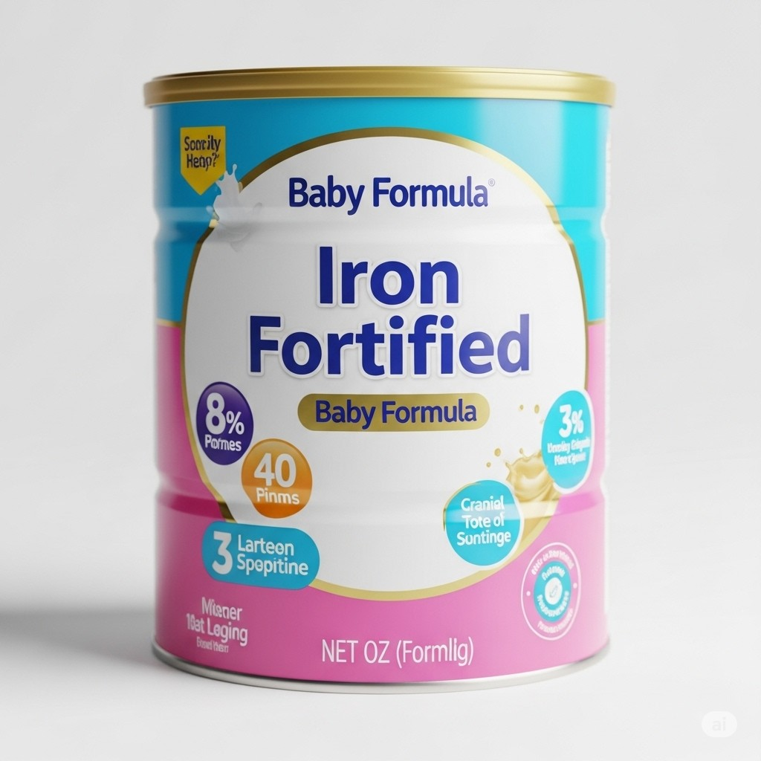
Infants and Required Infant Formula
Requirements
All Infants must be enrolled on the food program whether they are participants or non-participants on the CACFP
Parent may decline the providers house formula and provide their prefered formula. Prefered formula must be “Iron Fortified”. If parent provides own formula, a parent must fill out the “Declining Provider Formula Form”, and submit with Enrollment.
On the initial enrollment, Provider must specify which house formula he/she provides and which Iron Fortified Formula parent provides
Formula provided must always state “Iron Fortified”

Slide 5
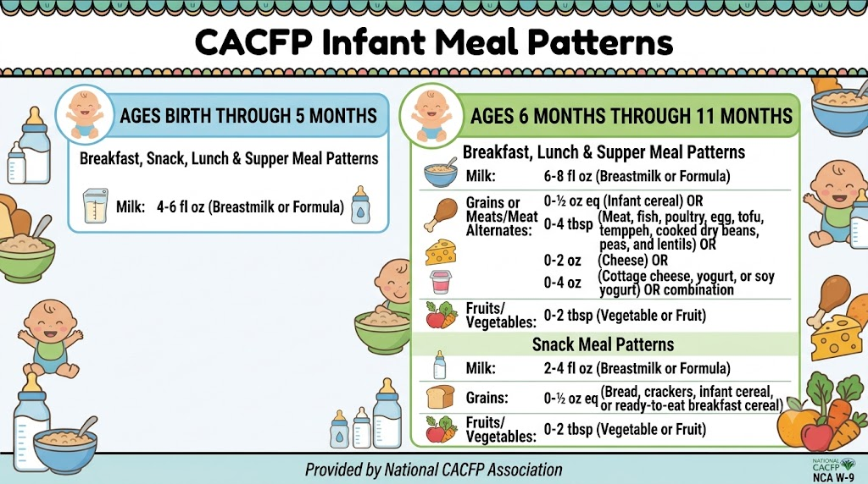
Infant Meal Pattern Chart

Slide 6
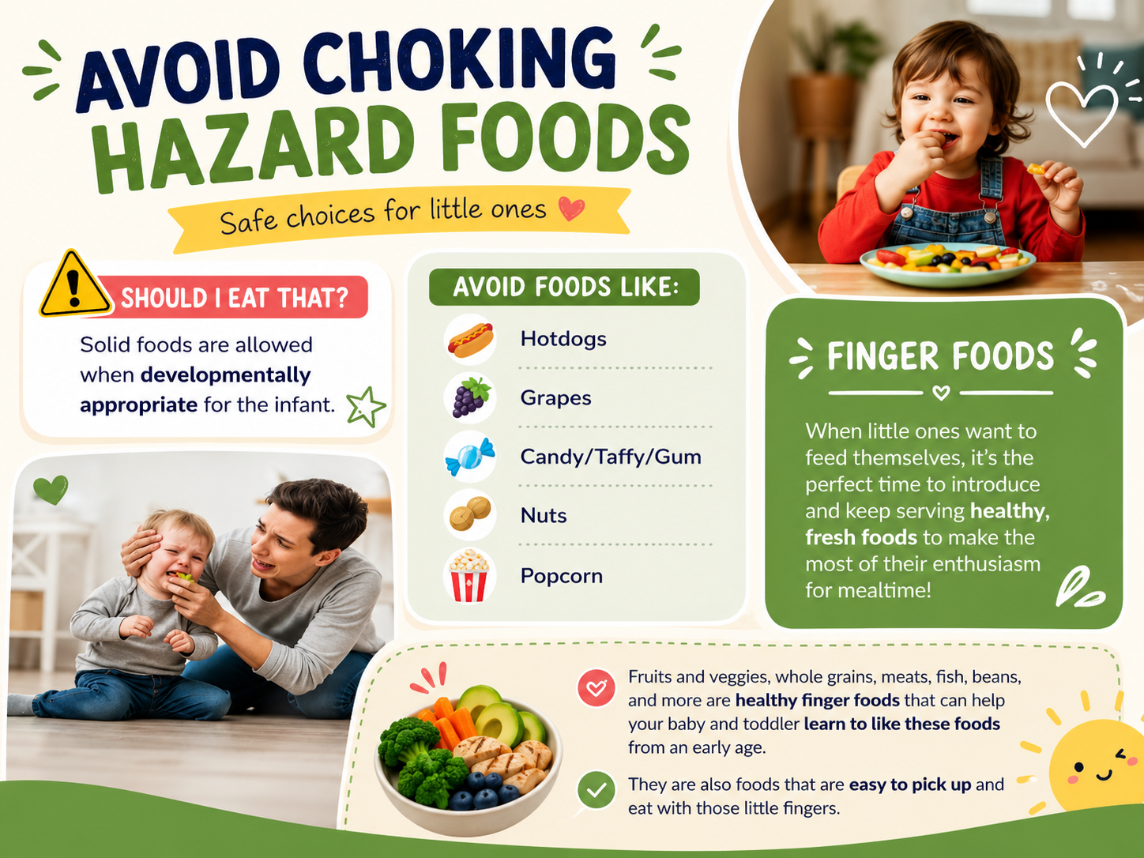
Avoid Choking Hazard Foods

Slide 7
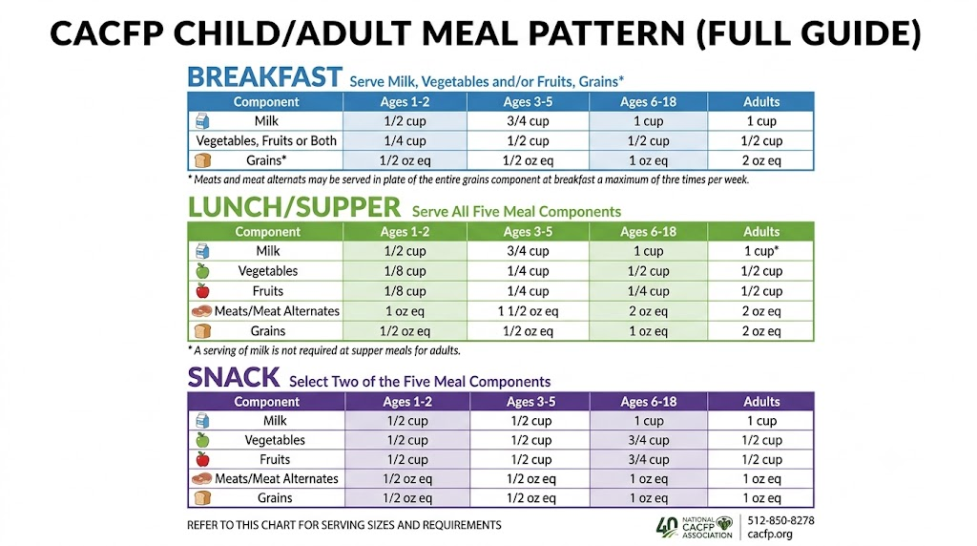
Older Children Meal Pattern Chart

Slide 8

Post Menu Sample

Slide 9


Post Cereal and Yogurt List
With the many USDA changes and sugar limit requirements, Angels CCFP requires that you post the Cereal and Yogurt List in their pantry or kitchen area.
Providers can only offer the Cereals and Yogurts that are on the list.
During home reviews, your representative may ask to see your postings and Items.
Your rep should have provided these flyers for you but you can also download them from our website. https://angelsccfp.org

Slide 10

Vegetables and Fruits

Slide 11
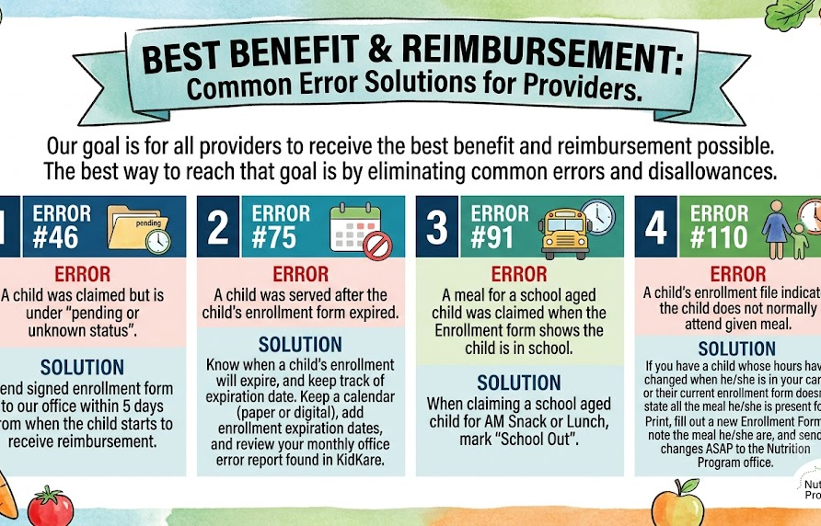
Mistakes often made

Slide 12
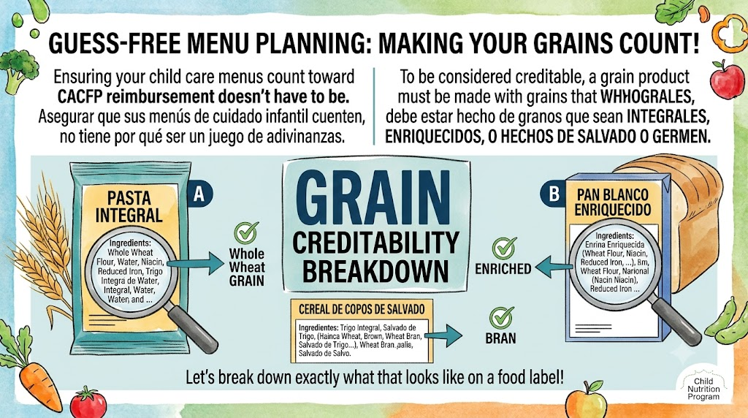
Decoding a Whole Grain

Slide 13
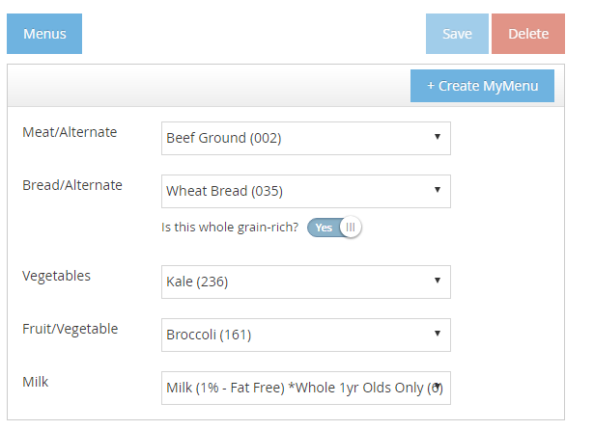
Claiming Whole Grains
CACFP Requires that whole grain/wheat be claimed at least once a day.
YES Only when Whole Wheat/Grain Served

Slide 14
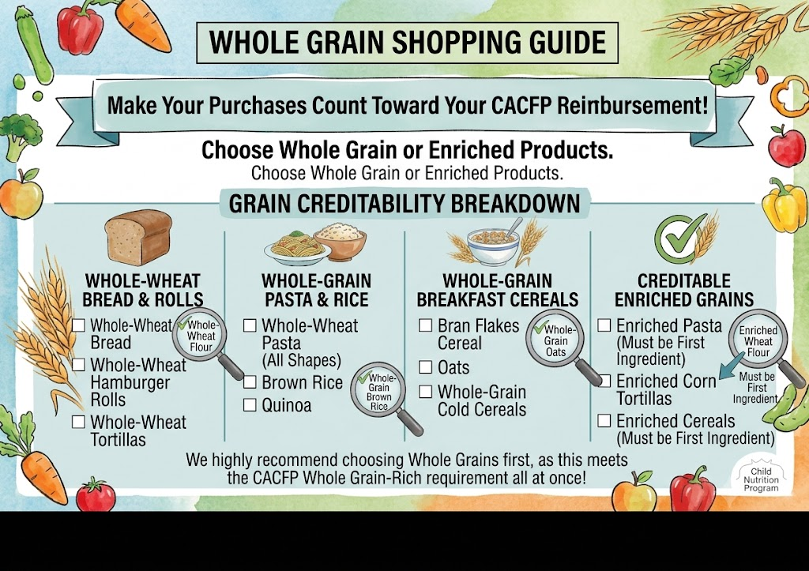
Whole Grain Shopping List

Slide 15
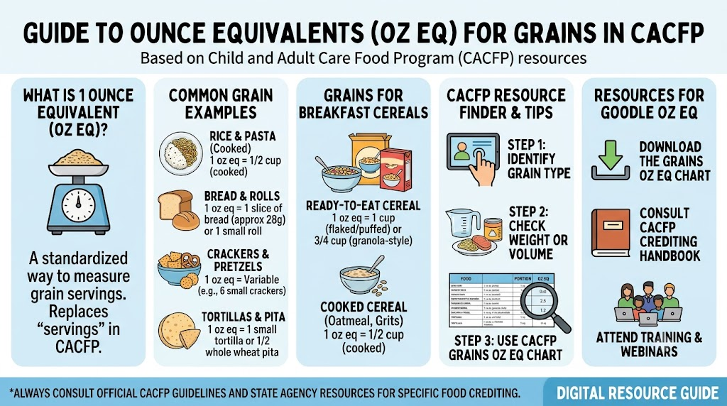
Using Ounce Equivalents for Grains
https://fns-prod.azureedge.us/sites/default/files/resource-files/CACFPworksheetGrainsOzEq%20.pdf

Slide 16

What are Grain-Based Desserts
Quick Take
Since October 1, 2017, grain-based desserts no longer count toward the grain component of a reimbursable meal or snack.
Not creditable
Cakes, cookies, brownies, doughnuts, granola bars, sweet rolls, toaster pastries, and dessert pie crusts.
Still creditable
Quick breads, cornbread, crackers, muffins, pancakes, waffles, French toast, tortillas, and savory versions of biscuits, scones, and pie crusts.
USDA Grain-Based Desserts worksheet (PDF)

Slide 17

Cereals, No more than 6 Grams
Of added Sugar per dry ounce

Slide 18

Guess what else can be served as a Meat Alternate?

Slide 19

Avoid Processed Foods

Slide 20

Yogurts – No more than 12 grams of Added Sugars

Slide 21
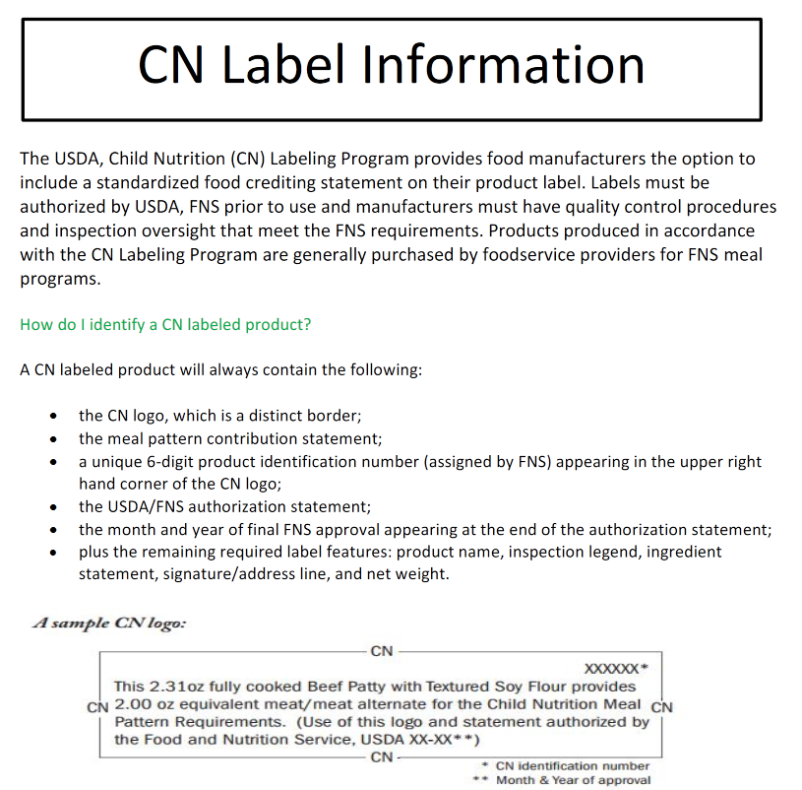
CN Label Information

Slide 22

Make Water Available
https://fns-prod.azureedge.us/sites/default/files/resource-files/CACFP_OfferingWater.pdf

Slide 23

Milk Part of Healthy Eating

Slide 24

Family Style Meals

Slide 25
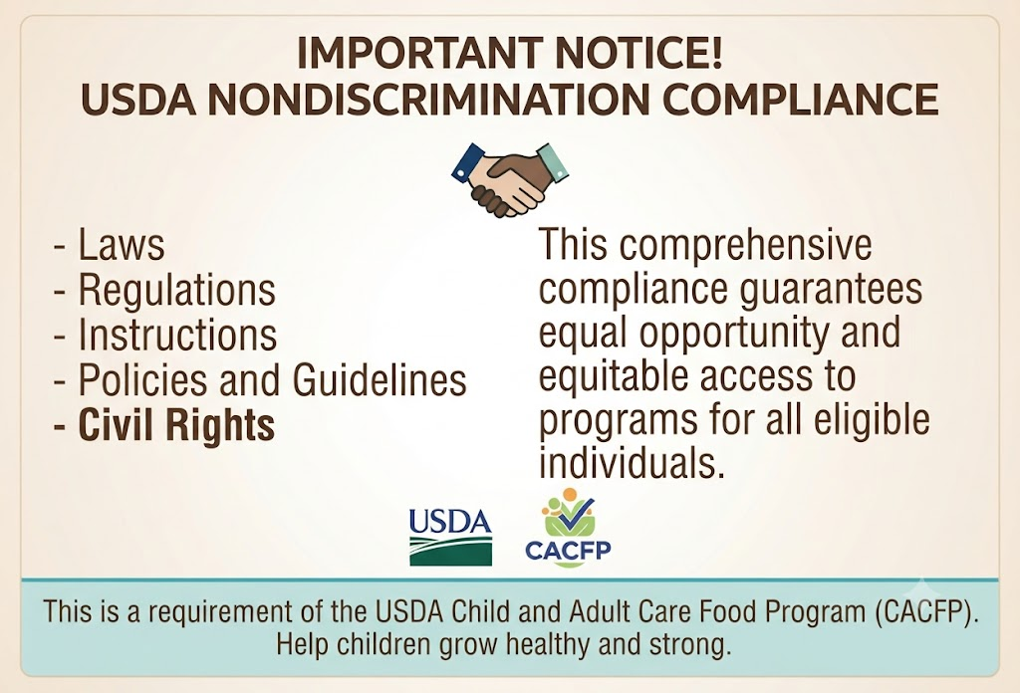
Civil Rights

Slide 26
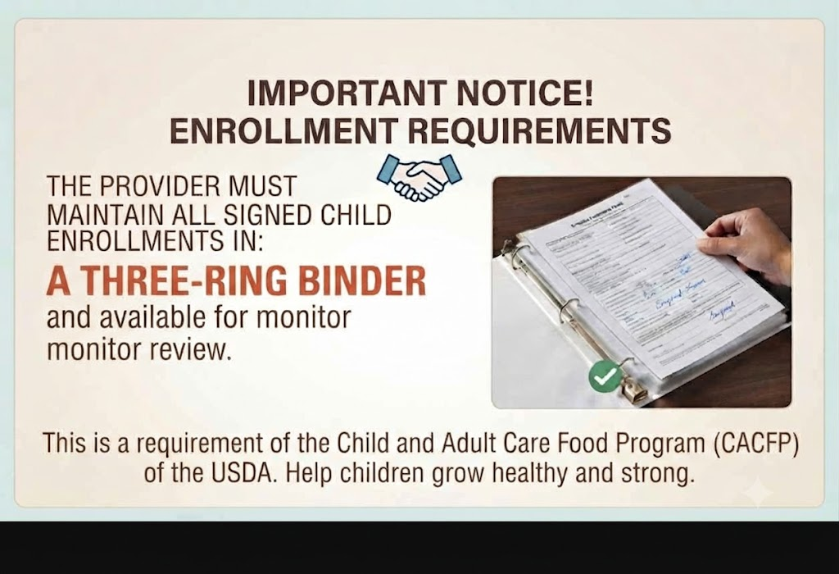
Enrollments

Slide 27
Review of Rules and Policies
Following Rules and Regulations will help you stay in compliance and help promote long lasting habits. Working together as a team we can accomplish this goal!
As a reminder, provider must;
Annual Training
Complete an online annual training.
School Age Children
Providers who claim online must remember to check off "Sch Out" or "Sick" anytime the school age child is out of school and in your care
Child Enrollments
Child Enrollments are to be submitted within 5 days from when the child start.
Parent sign date MUST be the same as date enrolled.
Keep a three ring binder for all records of enrollments and renewals and any other forms i.e. Copy of License Fee's, Completed (PEA's) Parent Eligibility Form's for Daycare, Foster, Helpers, Etc., Medical Forms, Decline Provider Formula Forms.
It is a requirements to keep signed copies for a period of 3 years with the current year available for review.
We will request to review this binder during our next monitor visit and all visits that follow.
It is the provider responsibility to make a copy of all signed enrollment and keep in file.

Slide 28
Review of Rules and Policies
Returning Children
When a child has been withdrawn and returns to your care, call the office to have the child reinstated.
DO NOT RE-ENROLL THE CHILD. The child is still in the system just needs to be reactivated.
Recording Meals
Daily record keeping is mandatory
Reimbursement is for 2 main meals and 1 snack or 2 snacks and 1 main meal
Meal Times
Breakfast before 9 AM
Lunch starting after 11AM and ending by 1:30PM
Supper between 4PM and 7PM
Meals must be served at scheduled meal times. Snacks may be served between main meals if at least two (2) hours are between the main meal and the snacks. No more than (3) hours may lapse between the start of the last meal.

Slide 29
Review of Rules and Policies
Claims
Have to be submitted before the 5th of each month
Review for accuracy
If computer or internet is down, make sure to complete a Daily Meal Worksheet
Claiming and receiving reimbursement for children not in provider care is fraud and will result in being declared Serious Deficient with the Department of Social Services and funds to be retracted.
Sign in and Out Records / TimeSheets
It is mandatory for the provider to maintain daily sign in & out records and have them available for review at every visit.
If you are claiming more children than your license allows, a Sign in/Out Record must be
submitted with your claim. You may print more Time Sheets here
If claiming online, then hours must be entered onto the KidKare Program. This will document that you are not caring for more children than what you are license for at any one time.
Angels CCFP may request sign in & out records to be submitted at any time,regardless of your capacity.
You must clearly show the shifts of care, recording actual in and out times with parent or guardian signature. Any over capacity findings will be reported to Community Care Licensing Division.

Slide 30
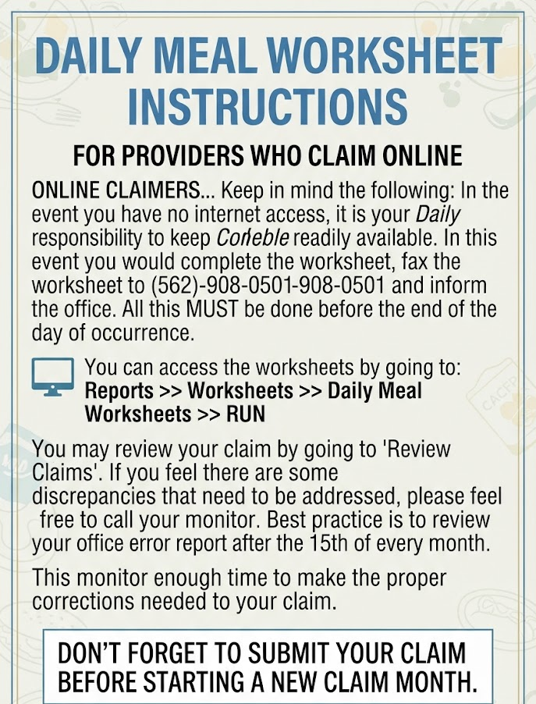
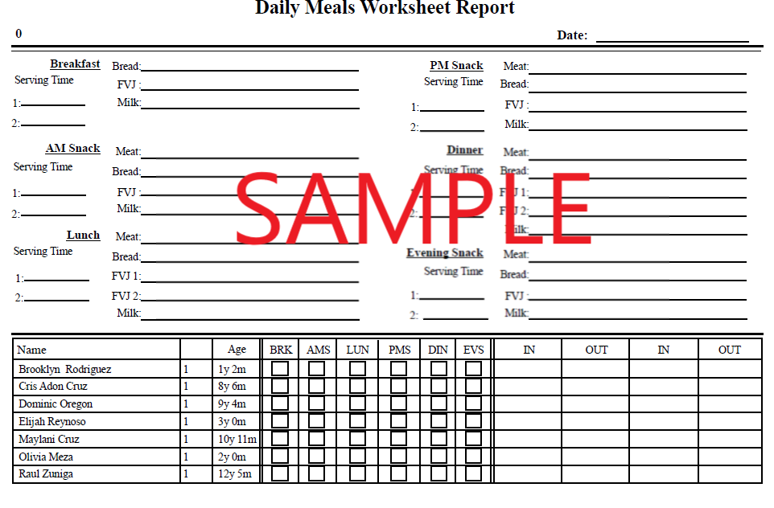
Daily Meal
Worksheets

Slide 31
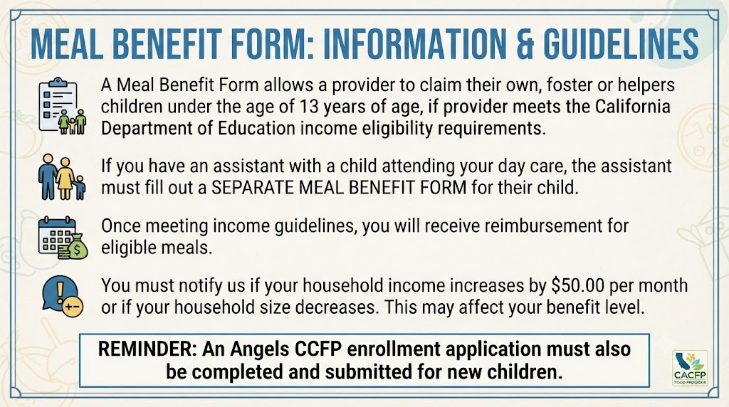
Meal Benefit Form
Claim your own Children

Slide 32
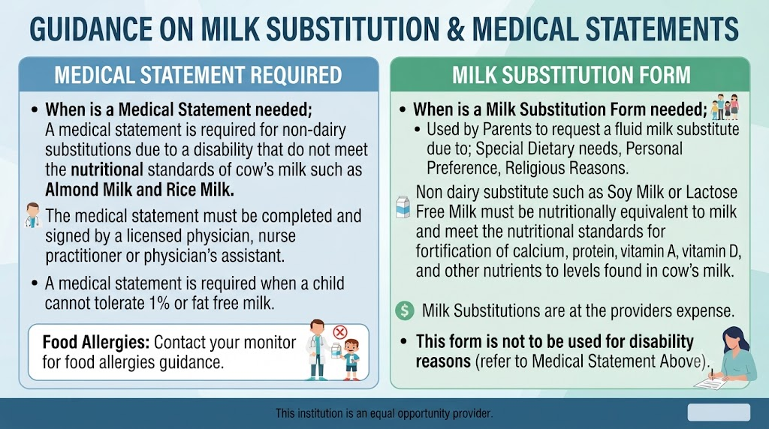
Medical Statement & Milk Sub Form

Slide 33
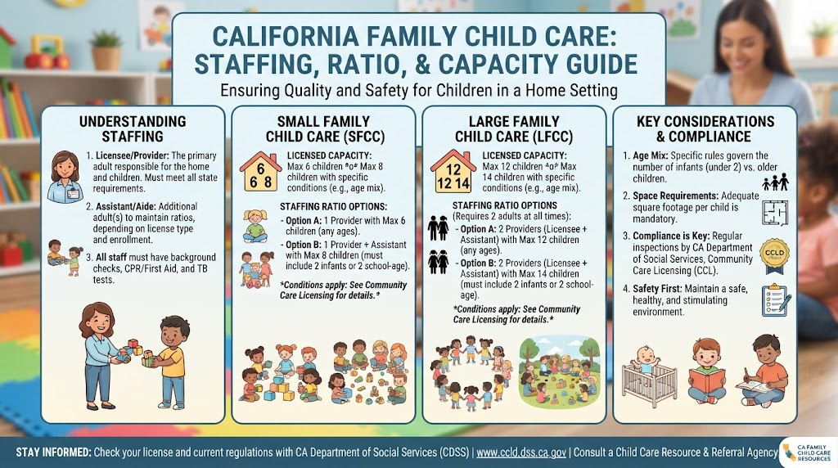
Capacity Regulations

Slide 34
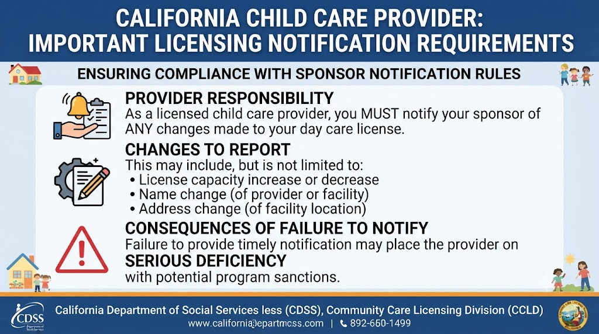
Home Daycare License

Slide 35
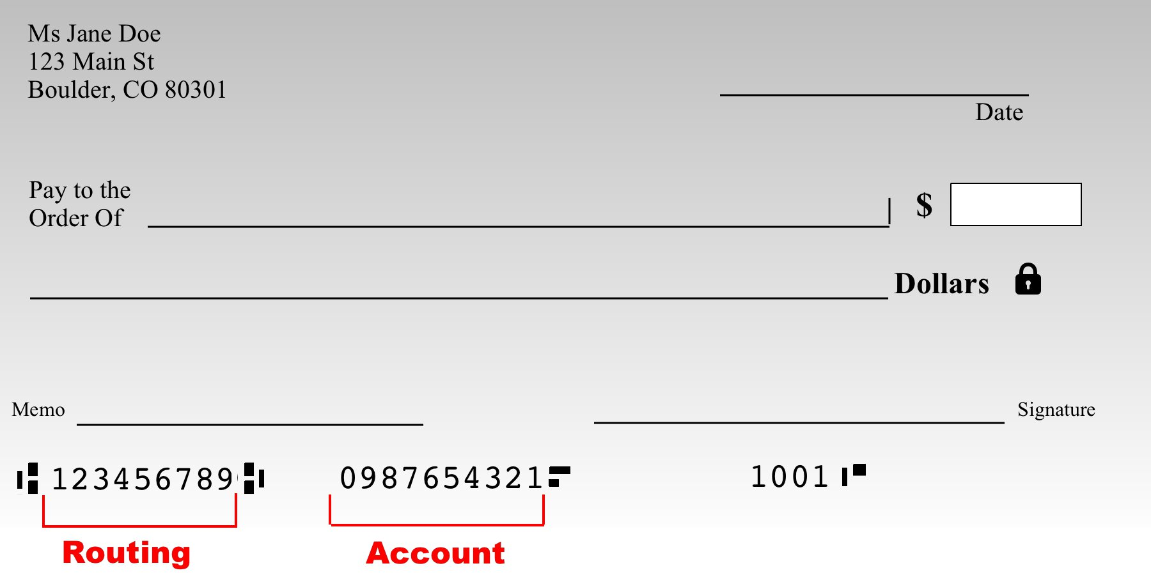
Home Daycare License Fees
Did you forget something?
SUBMIT YOUR PROOF OF PAYMENT
Licensing Renewal:
Federal rules require that in order to participate in the Child Care Food Program, you must have a current child care license. Since most licenses do not have an expiration date, you are required to pay annual fees in order to keep your license current.
As proof that you have paid your fees, you will need to send us a copy of either of the following;
COPY OF YOUR CANCELED CHECK (FRONT & BACK)
MONEY ORDER
IF PAID ON-LINE A COPY OF ON-LINE RECEIPT
COPY OF BANK STATEMENT
If we do not receive proof of renewal documentation before renewal due date or if fees are paid late, your claim reimbursement will be affected and may not be processed. At any time, if we are notified by licensing of a revocation of your license due to non-payment of fees or for any other reason, your participation on the Food Program will cease immediately.

Slide 36

Monitoring Visits
MONITORING VISITS:
The Day Care Home will be monitored, unannounced, at least three (3) times a year. During this visit your monitor will observe children, meals, and records. Your monitor will also provide training and answer any questions you may have. In the event that only the assistant is available, the assistant must be trained and have access to all records. Failure in record keeping can result in disallowance for the month and corrective action.
If during a review your monitor observes less children than what is normally claimed, the provider may be subjected to an escalated review that may include parent contact and loss of meal privileges.
Call the Office
Provider must notify the sponsor when day care will be closed.
By regulation:
Provider must notify the office if he/she will be away from their facility during a scheduled meal time.
Notifying the sponsor avoids the chance that the Monitor will arrive for an unannounced visit and find no one at home. Meals normally claimed during that day would then be disallowed and provider may be found as serious deficient.

Slide 37

DO NOT CLAIM CHILDREN

Slide 38
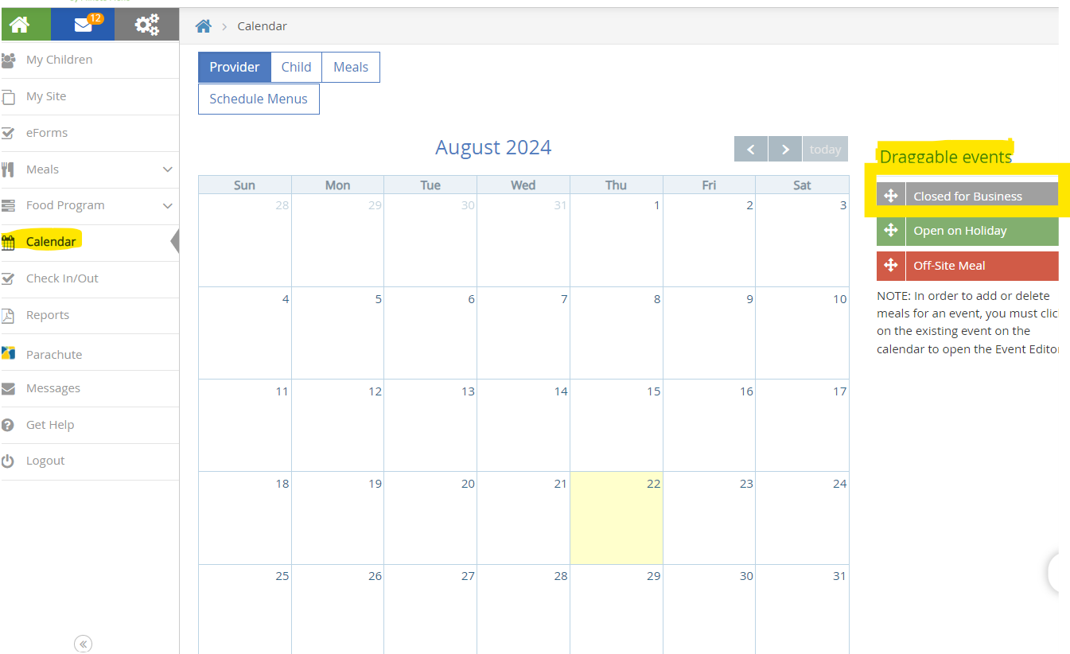
Mark your Calendars
Mark your Calendars:
We understand that at times you may close on emergency basis and did not have a chance to record the day prior.
Although, we can not allow providers to go back and claim. Please make sure that the next time you log in, you mark your calendars “Closed for Business”

Slide 39
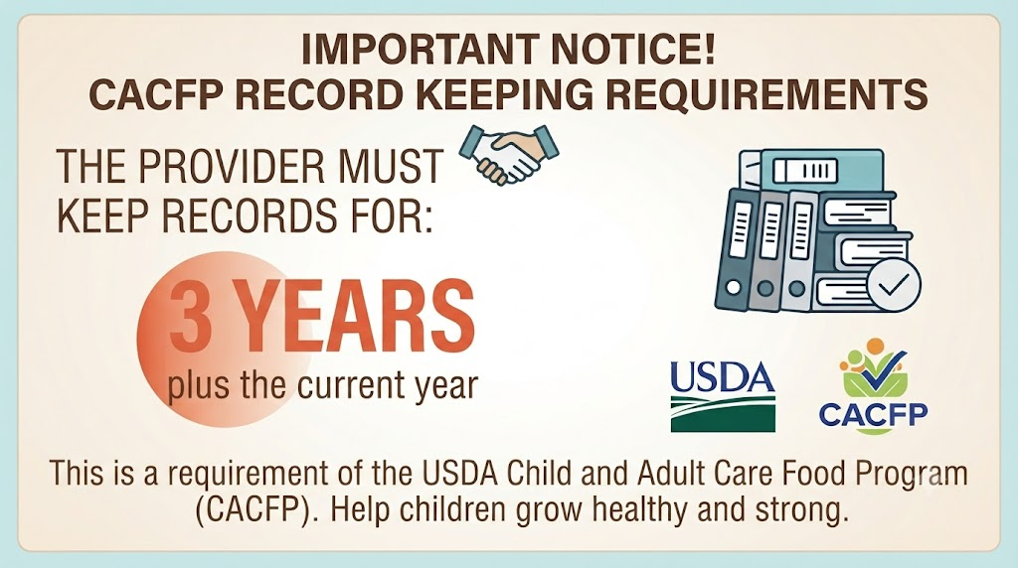
Record Keeping

Slide 40
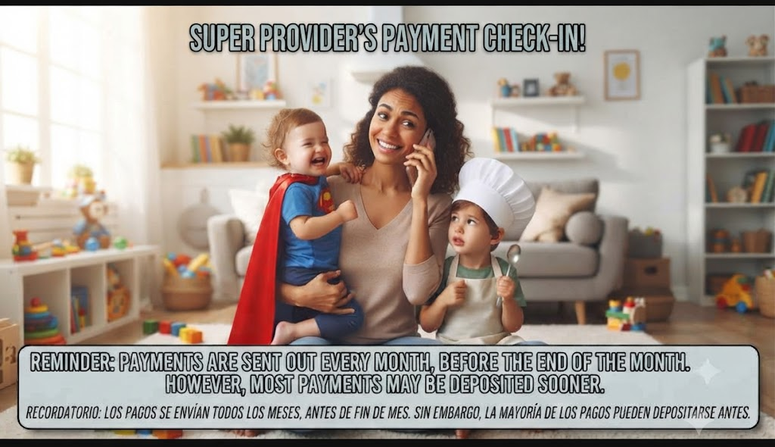
Reimbursement Payments

Slide 41

Serious Deficiency Warnings
How to avoid Serious Deficiency with your Sponsor
Menus, Attendance and/or Timecards not up to date
Failure of retention of records
Not notifying sponsor when daycare closed
False Claiming
Claiming children not in attendance
Pre Claiming
Not meeting meal pattern requirements
Over capacity
Failure to complete an annual workshop training
Not following Meal service times
Altering records after review
Missing enrollments
Meal observed different from what was claimed
Failure of notifying sponsor of license status

Slide 42


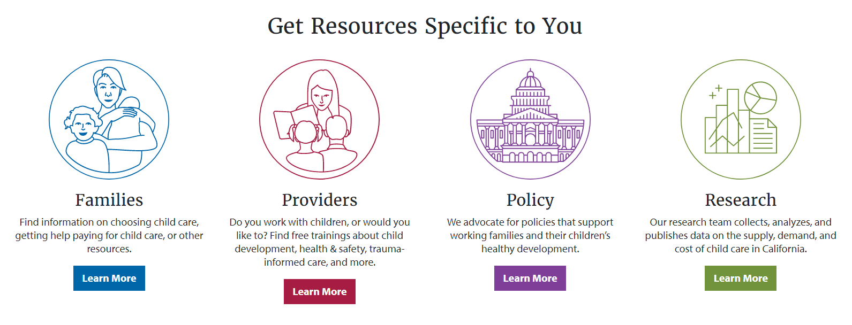
Additional Resources
WIC - Special Supplemental Nutrition Program for Women, Infants and Children (WIC)
CDSS - California Department of Social Services
Resource and Referral Services

Slide 43

Click Here to
Take Quiz

